Slide 1
MOLM13 and K562-IDH mutated models (Xu Lab). -> enzymatic activities
R1/R2: malonate inhibits 100% but TTFA inhibit max 30% of activity
V0 maintain activity – aspecific or error in mix préparation?

Slide 2
MOLM13 and K562-IDH mutated models (Xu Lab). -> drugs sensitivity
IC50 – 24h RPMI + 10% SVF
Ven
AraC
Ida
K562 IC50 > 100 µM
K562 IC50 > 100 nM

Slide 3
MOLM13 and K562-IDH mutated models (Xu Lab). -> drugs sensitivity
Irono
ELT

Slide 4
MOLM13 and K562-IDH mutated models (Xu Lab). -> VEN + conventional chemotherapies
Attention
R1: Ven1 + Ida 10
R2: Ven1+Ida 5
R3: Ven200 + Ida5
K562-IDH2 plus sensibles à la combinaison?
Ven+Ida
Ven+AraC
Attention
R1: Ven1
R2: Ven1
R3: Ven200
Ven+Aza

Slide 5
Ven+ONC
AraC+ONC
Ven+CPI
AraC+CPI

Slide 6
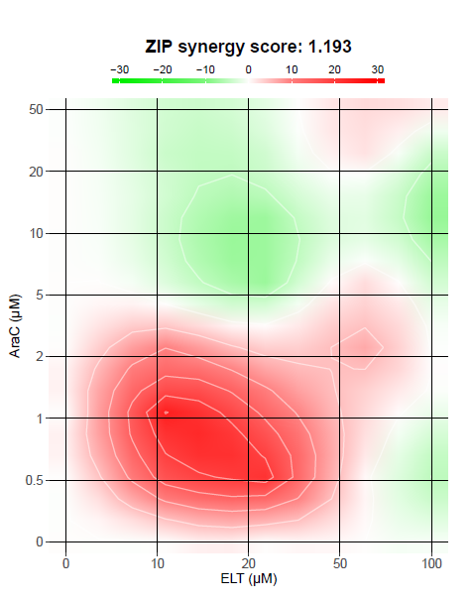
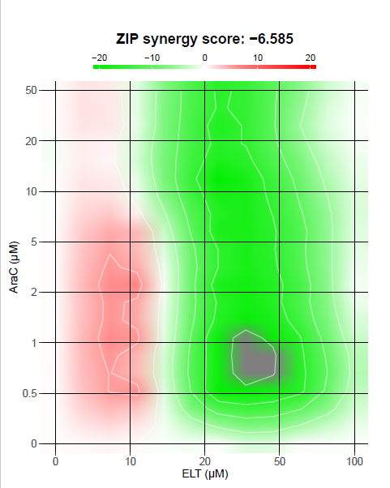
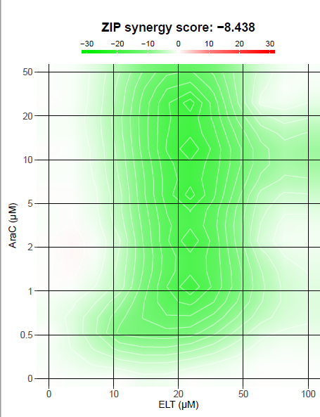
Test compusyn pour Ci mais pas fonctionnel sur mon PC

